Slide 1
REACT JS

Slide 5
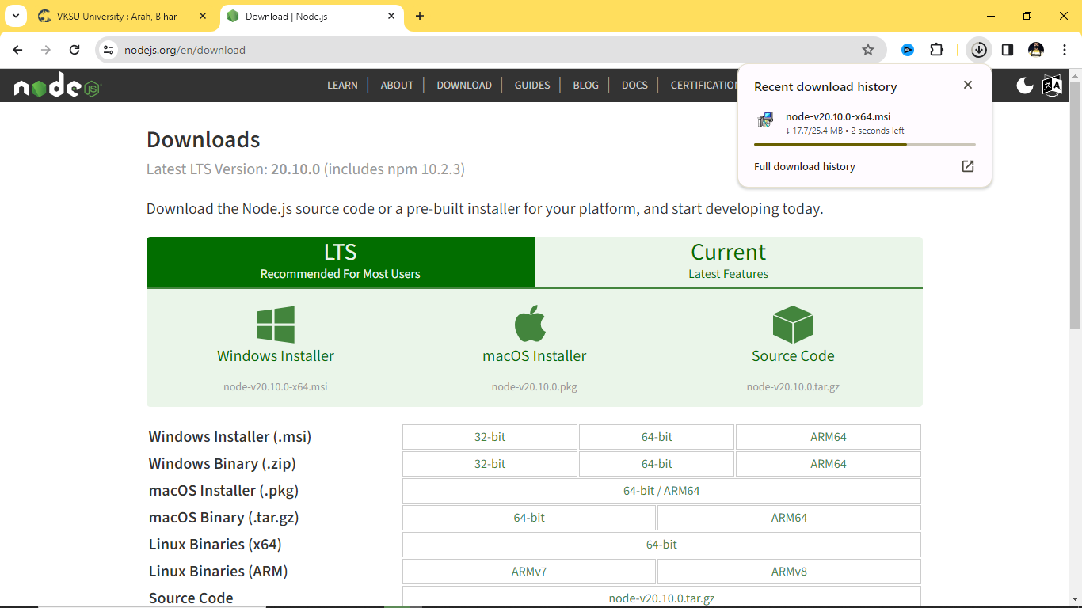

Slide 6
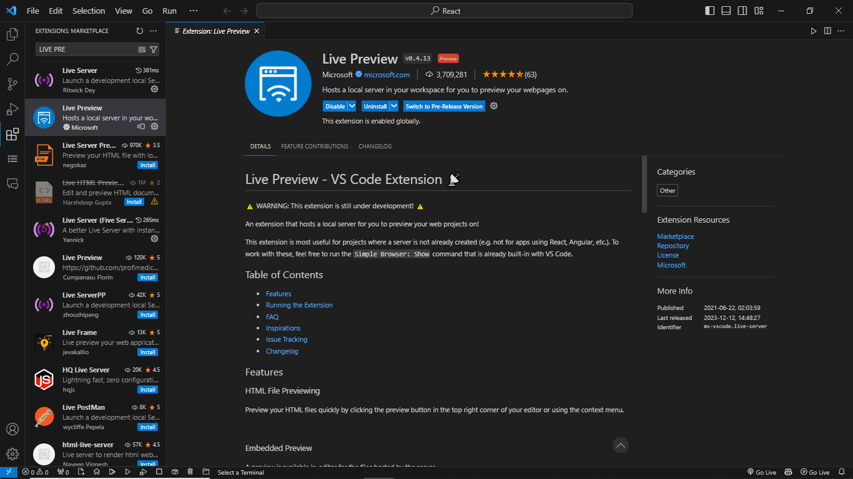
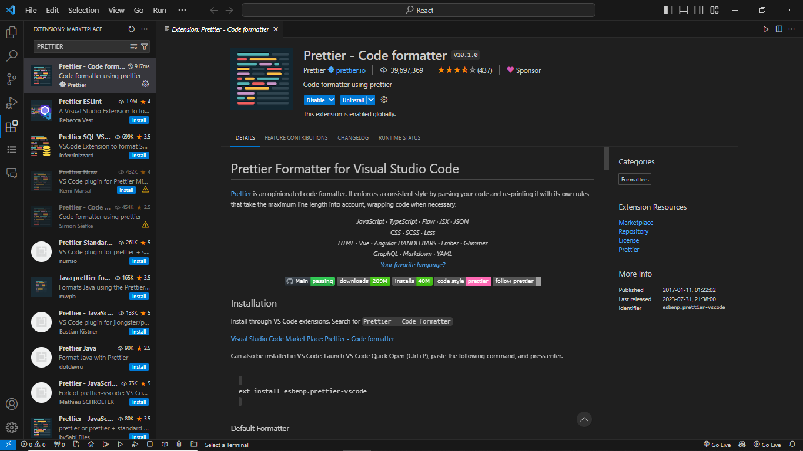
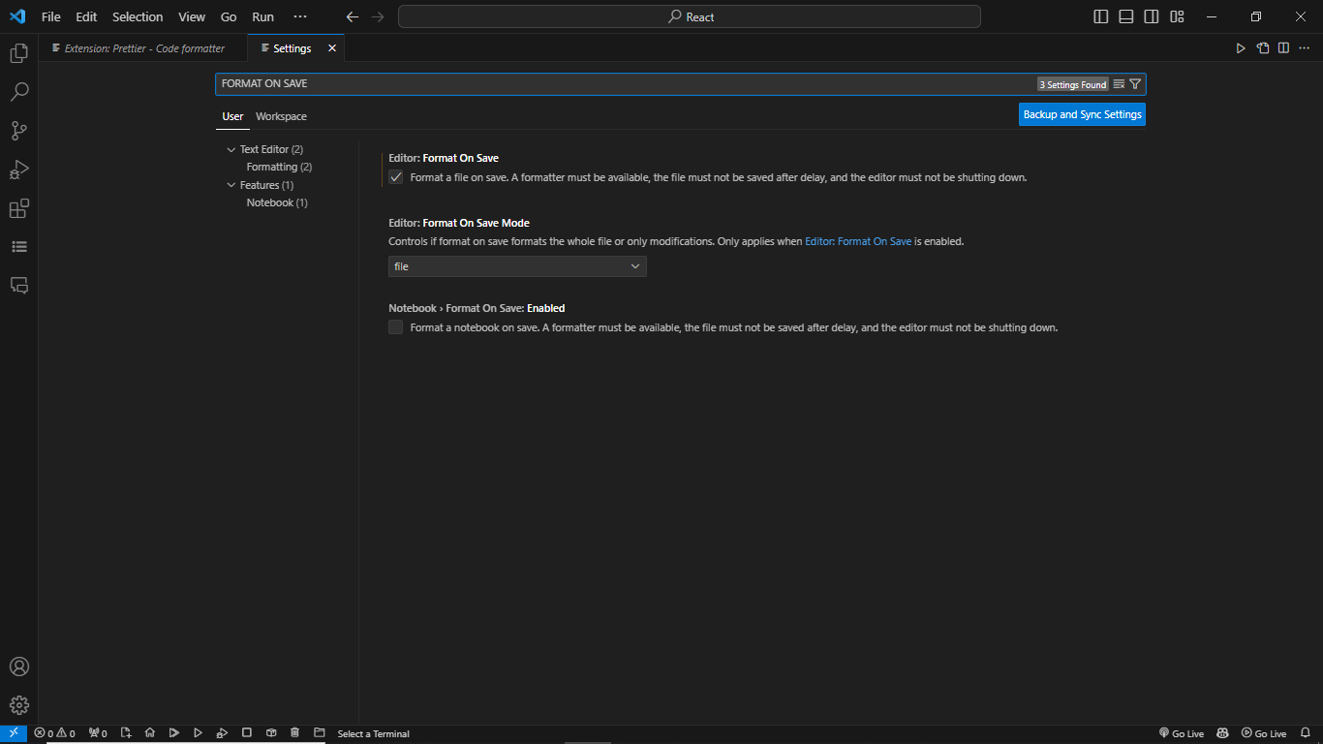

Slide 7
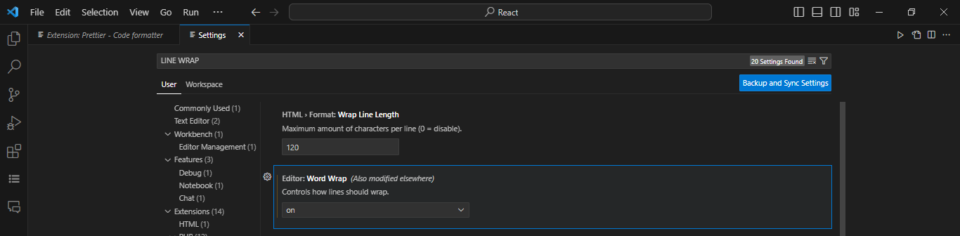
Vite:
Vite: Use npm run dev to launch dev server.
Use npm start for CRA

Slide 8
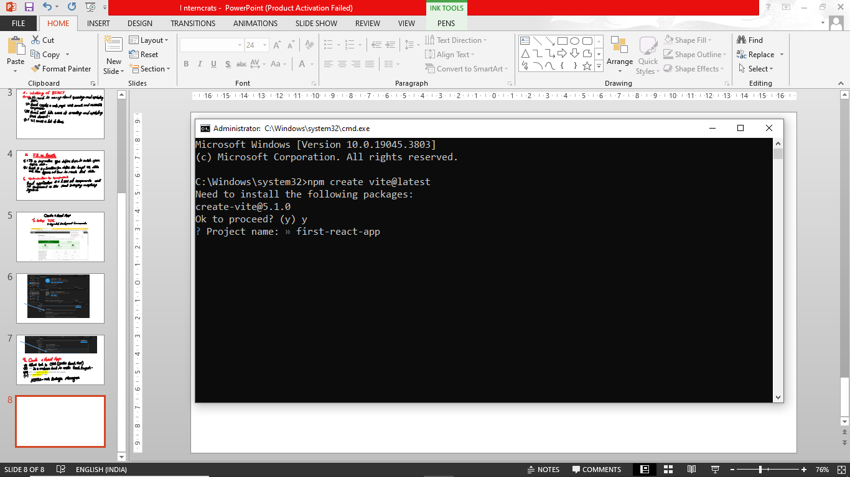

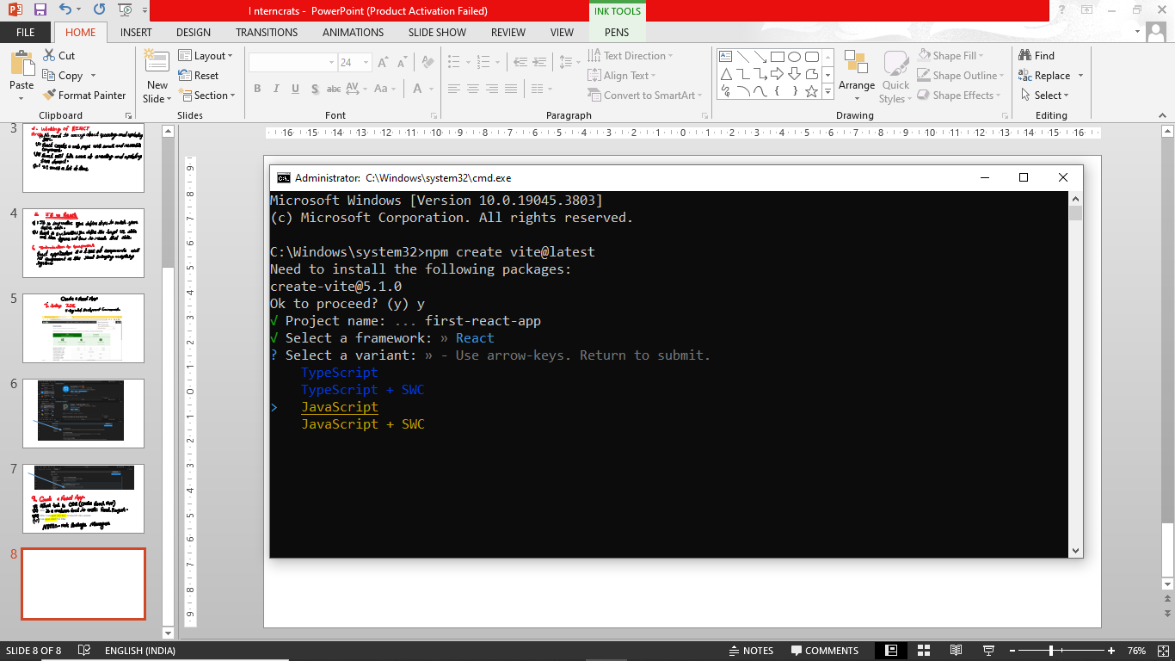

Slide 9
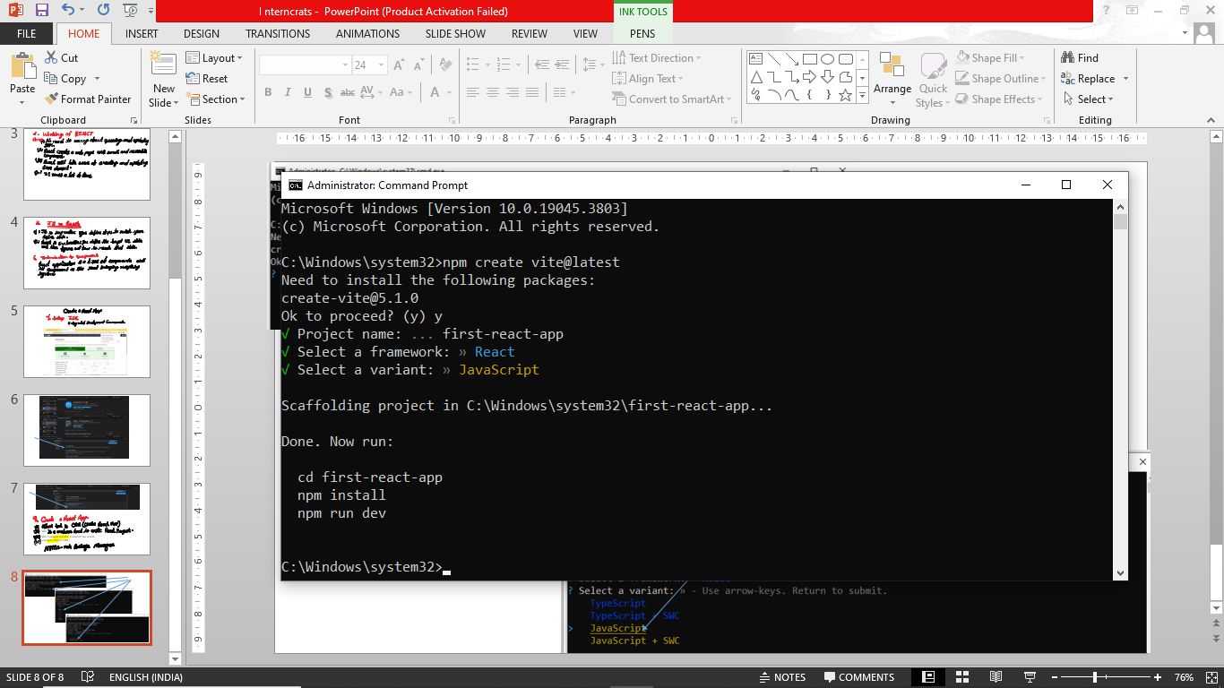
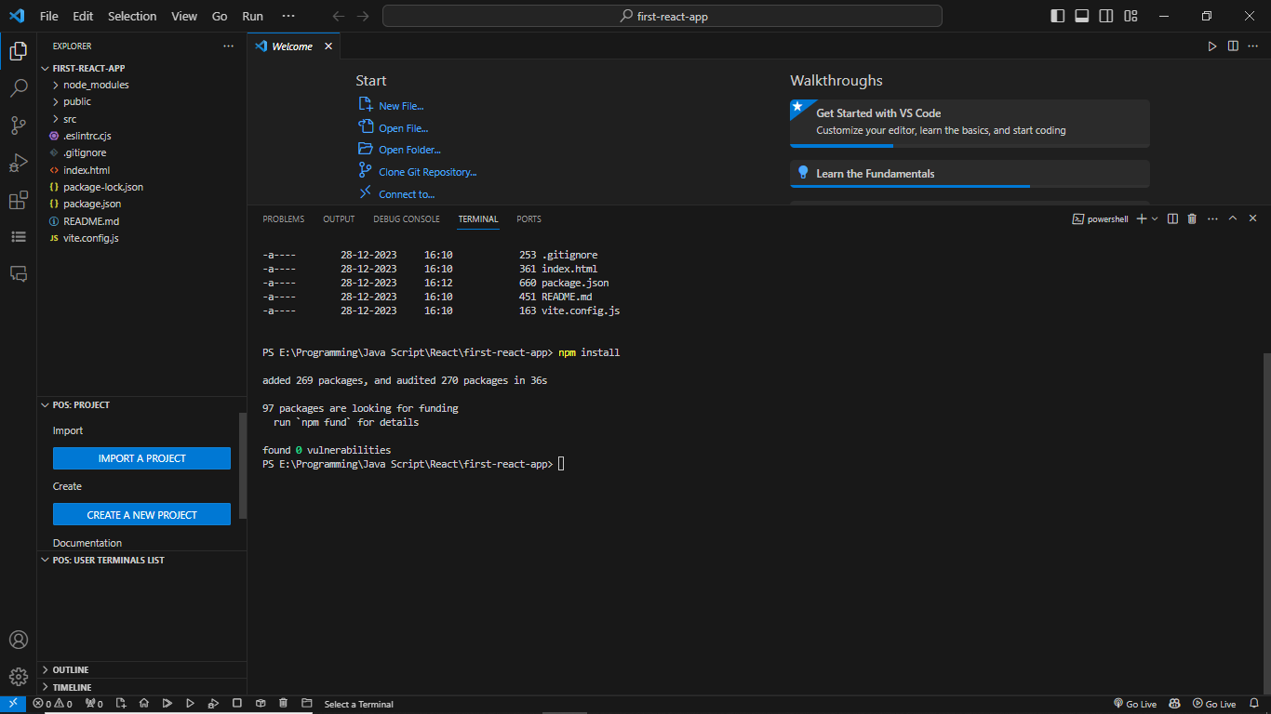
When run npm install then file will be create node_modules

Slide 10
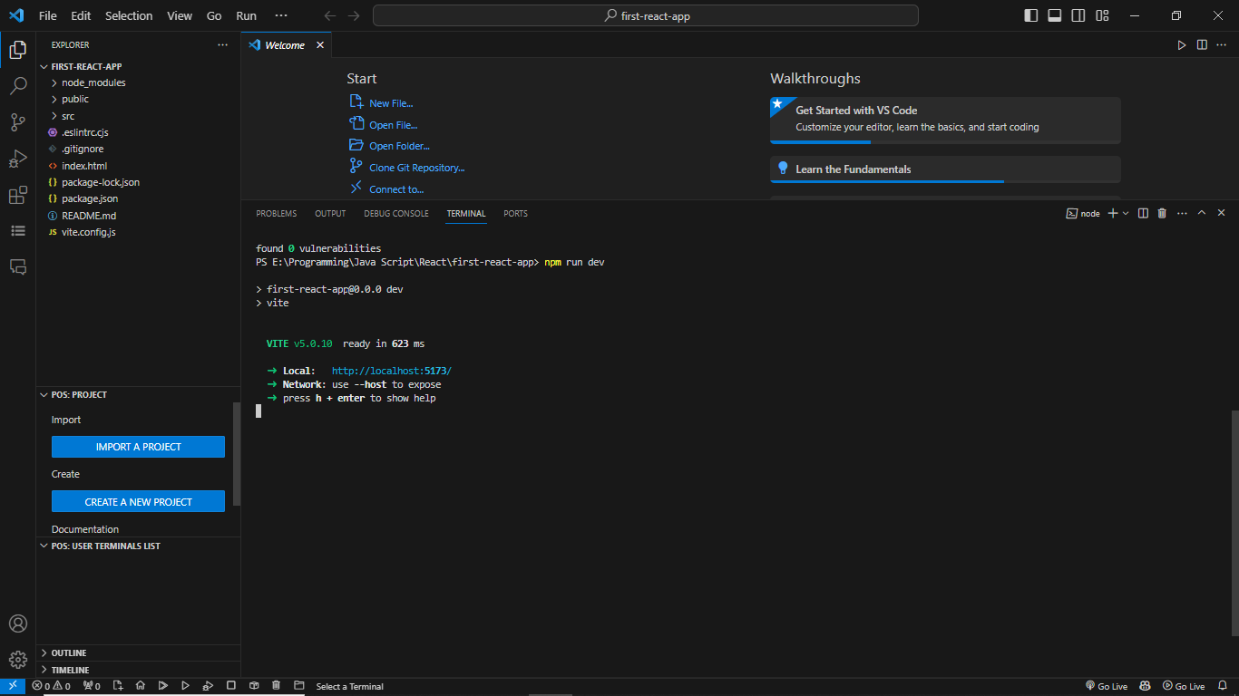
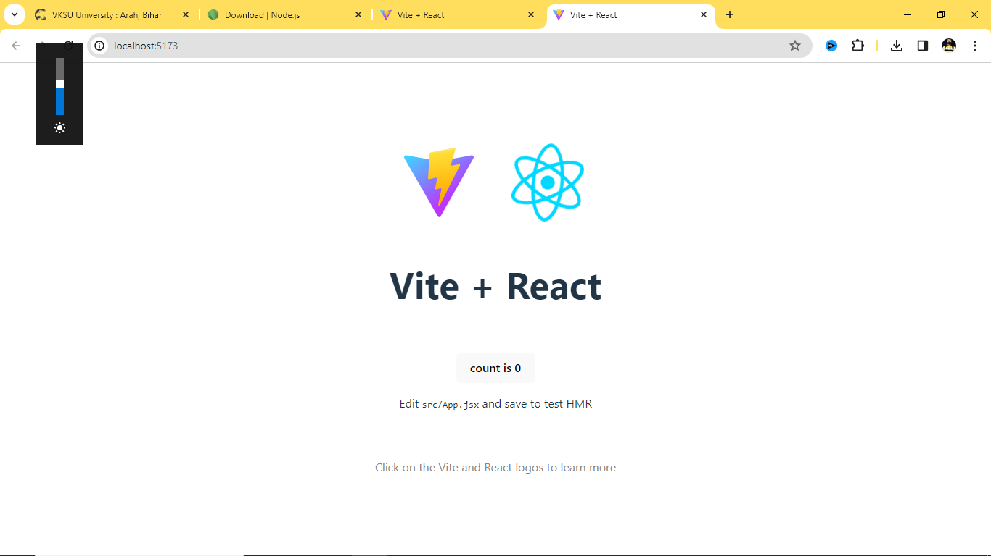
npm run dev
command
Server started
Ctrl + left click

Slide 11
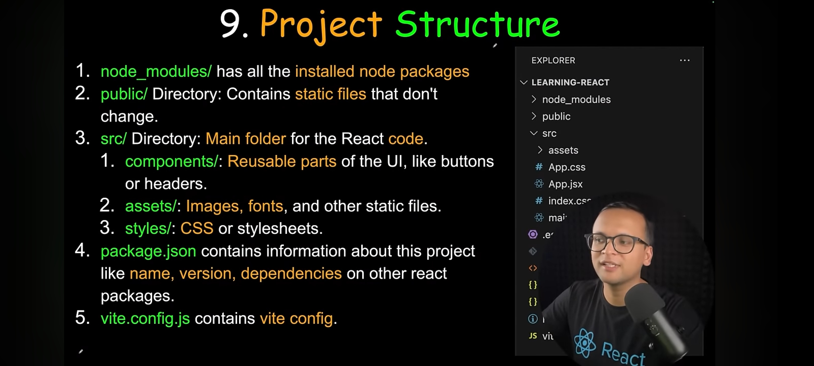

Slide 13
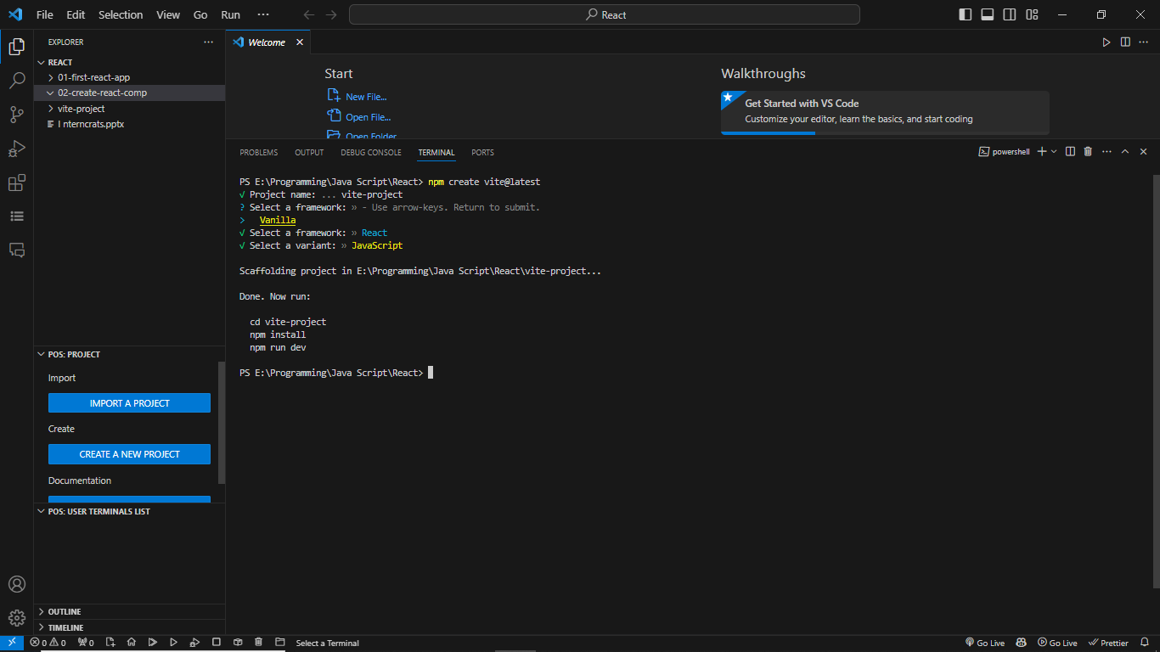

Slide 14
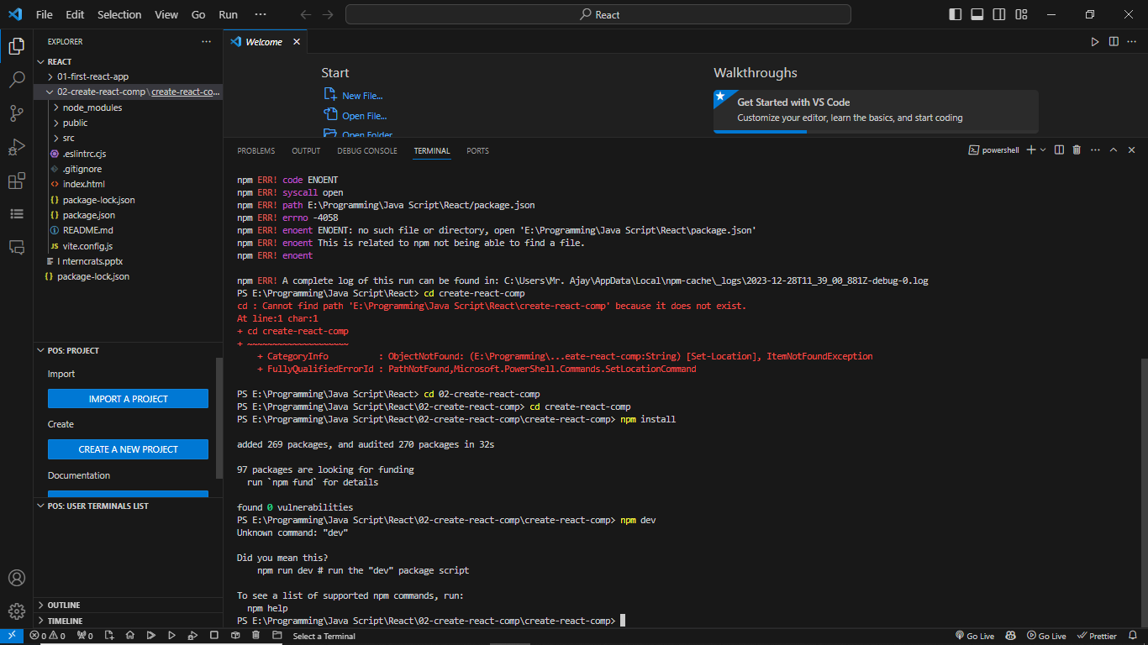

Slide 15
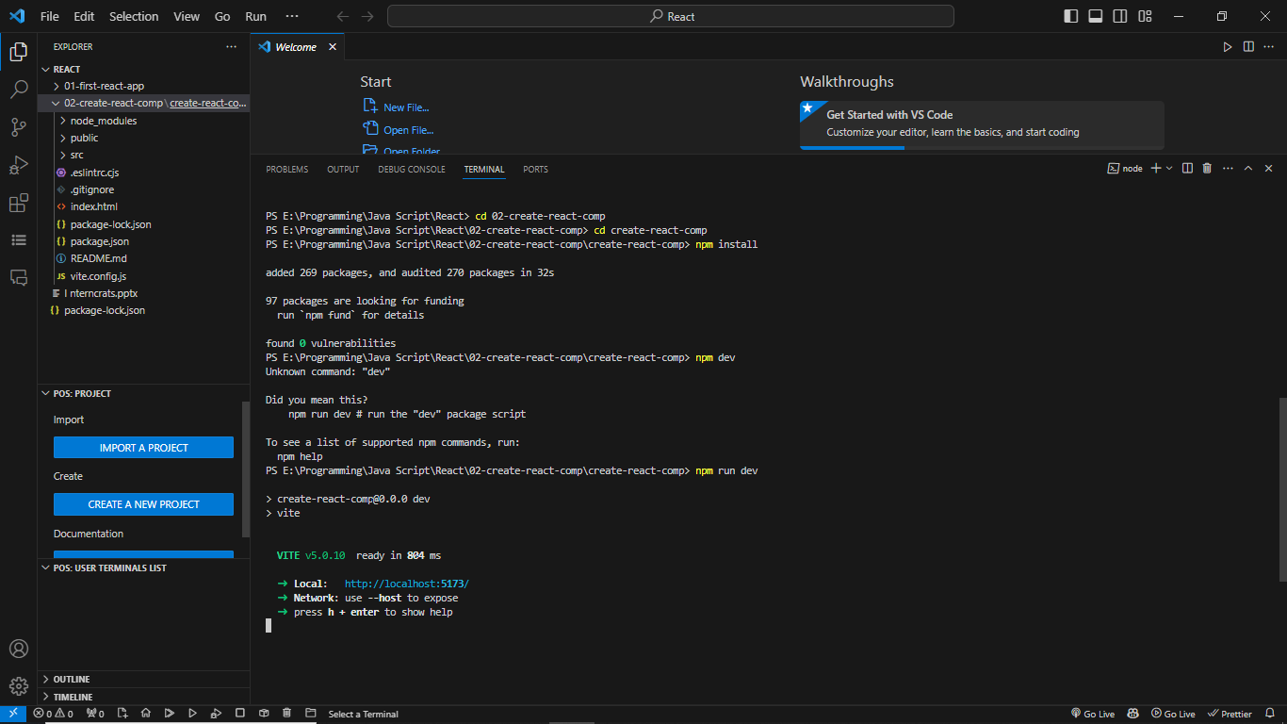

Slide 16
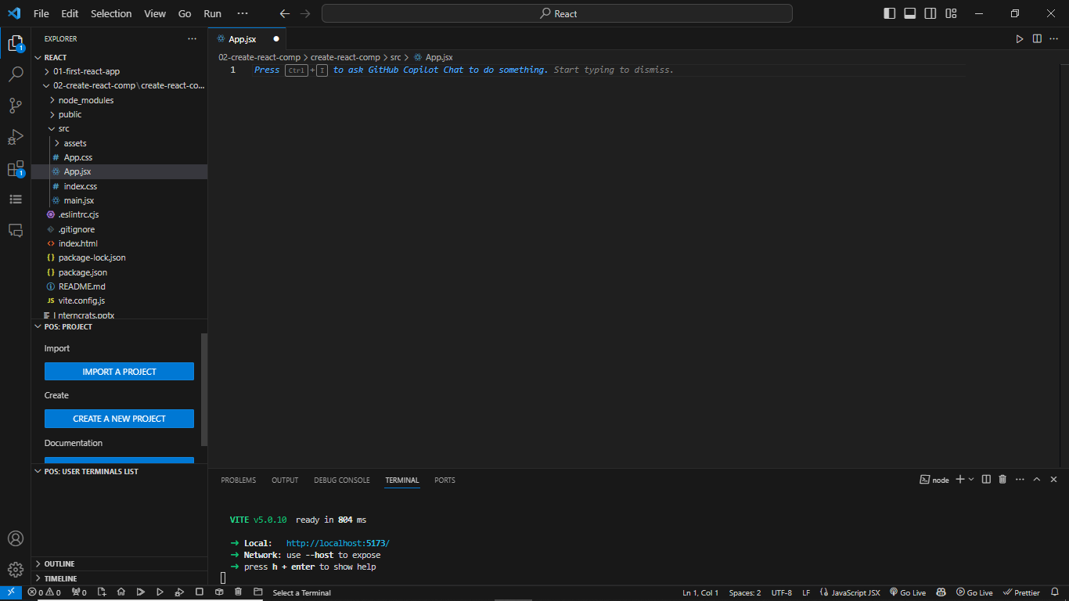
I have remove every thing from app.jsx file
29-12-2023 13:20

Slide 18
export default function Button(){
……….
}
export function Button(){
……….
}
export function Button(){
……….
}
export function Button(){
……….
}
export function Button(){
……….
}
export default function Button(){
……….
}

Slide 21
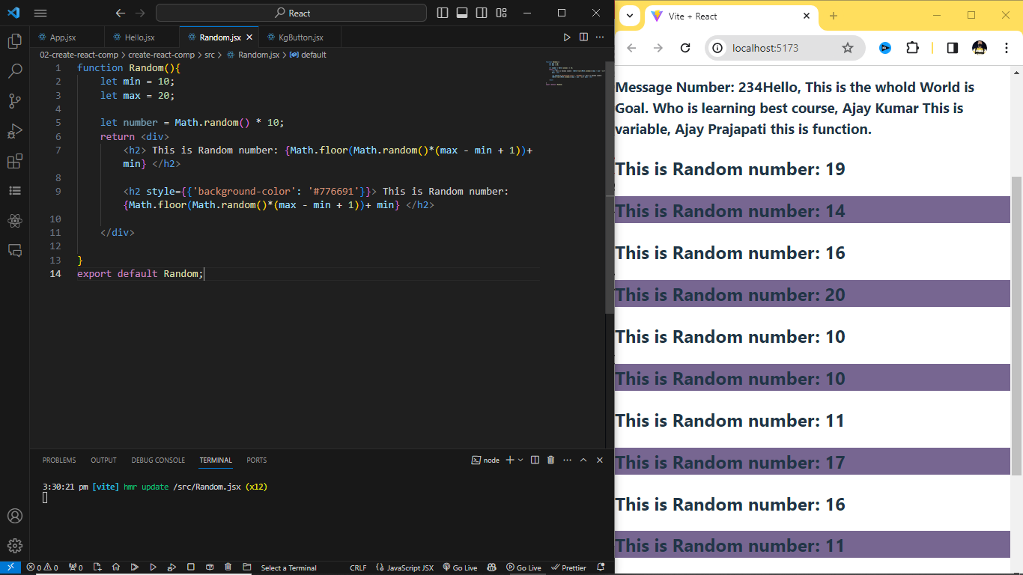
CSS Writing Syntex

Slide 22
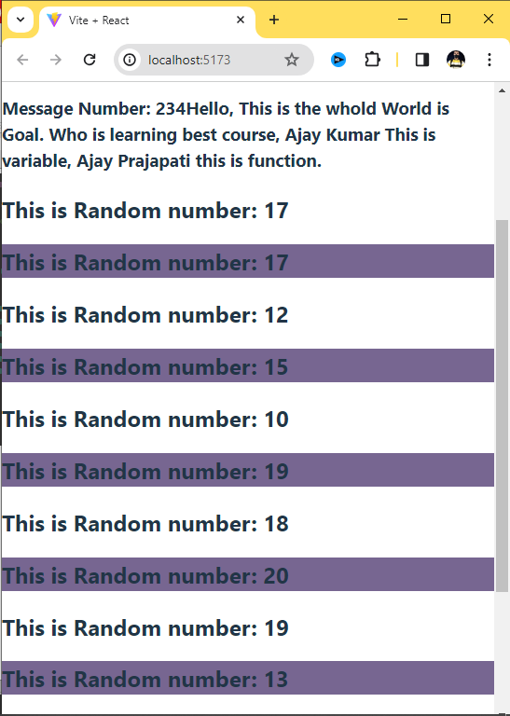
import KgButton from "./KgButton";
import Hello from "./Hello";
import Random from "./Random";
//Functional based Component
function App(){
return <div>
<h1>This is the Best React Course.</h1>
<KgButton></KgButton>
<Hello></Hello>
<Random/>
<Random></Random>
<Random></Random>
<Random></Random>
<Random></Random>
<Random></Random>
<Random></Random>
</div>
}
export default App;
Self Closing tag:
<random />
Install:
npm I bootstrap@5.3.2
Import:
import “bootstrap/dist/css/bootstrap.,in.css”;

